Slide 1
STAT 441: Kaggle Competition
How important is religion in your life?
Group 7
JeongHan, JaiYeon, Amy

Slide 2
Software and Packages
Data Preprocessing
Language: Python, R
Packages: Pandas, Numpy (Python), Basic packages for previous STAT 441 assignments(R)
Model
Language: Python
Model name: Xgboost, Neural Network, LightGBM, SVM, Random Forest
Packages: Numpy, Pandas, Scikit Learn, Xgboost, Pytorch, lightgbm, Bayesian Optimization

Slide 3
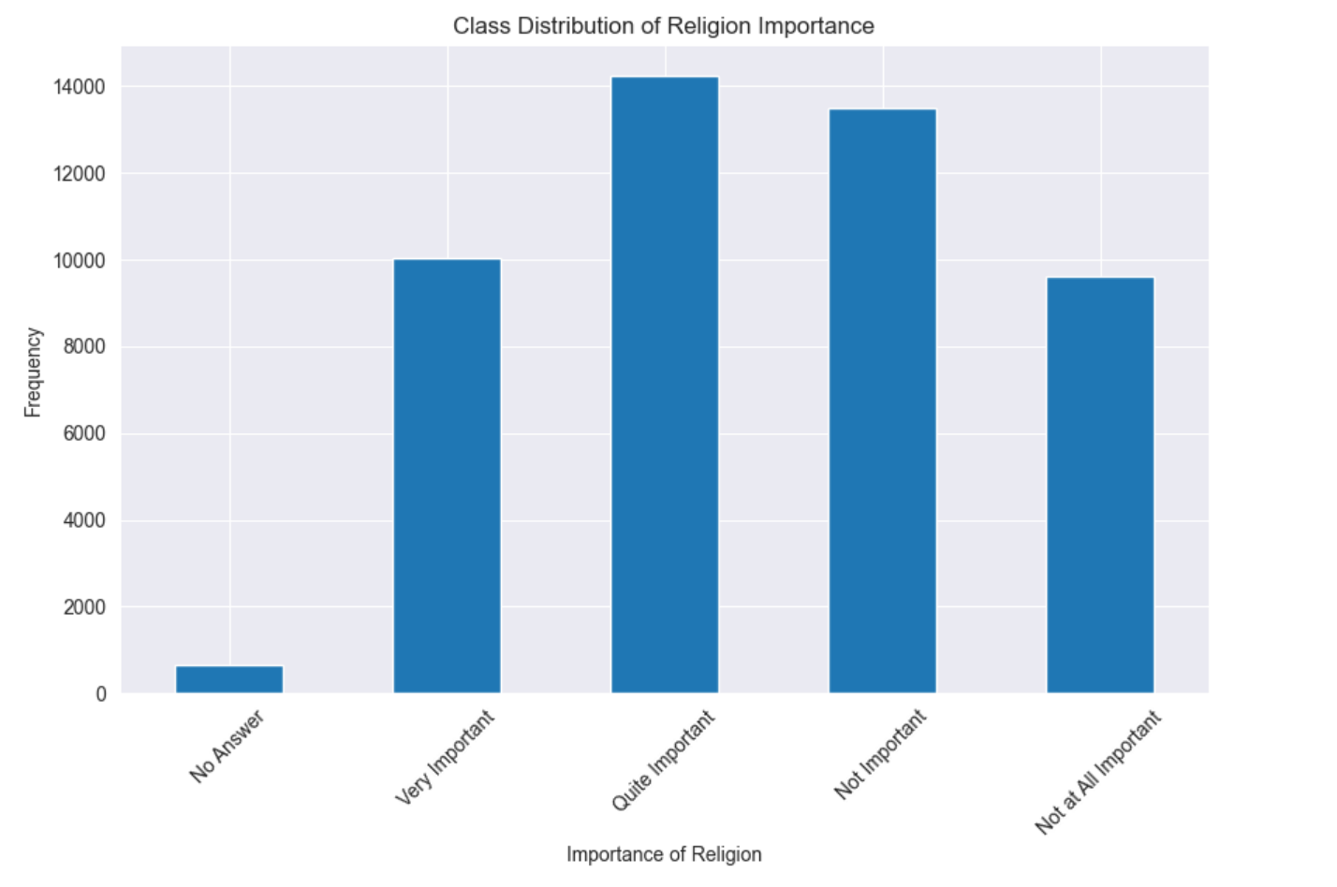
Exploratory Data Analysis
Our dataset comprises 48,000 training and 11,438 test observations, each reflecting a survey response on the significance of religion in an individual's life across various European countries.

Slide 4
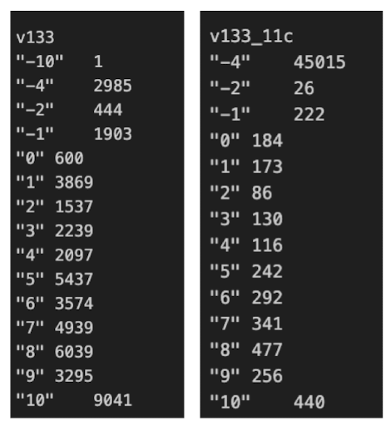
Exploratory Data Analysis
Data cleaning
Columns with NA values → Imputation with ‘-3’
Dropped country specific columns (*_GB, *_DE)
Dropped non-numerical variables after confirming the relation with numerical type variables
Merge Column
Merged “Modified” questionnaire columns with their original questionnaire columns.
(ex: variables end of *_11c)
Sum of v133_11c ≠ -4 => 26+222+184+...+440 = 2985
Notes:
From Original questionnaire column’s -4, which is a column for not applicable, it matches with 11c’s total observation’s

Slide 5
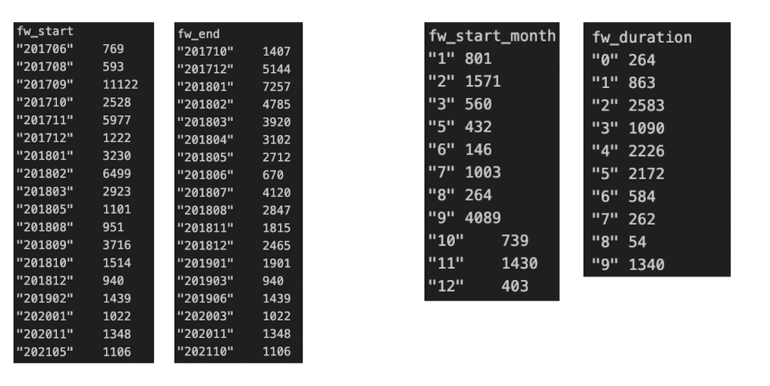
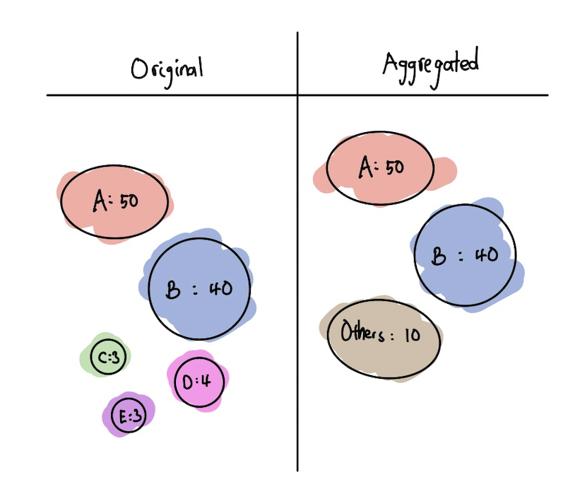
Exploratory Data Analysis / Feature Engineering
Aggregation
Some variables have extensive unique values (ex: v252_cs : 525 unique) => High Cardinality
Used simple aggregation method to merge categories
Aggregated until the sum of frequency is above 90%
Time Variable Adjusted:
Dropped irrelevant time data: (ex: fw_start, fw_end, v278a, ...)
Created new columns to compensate such dropped columns:
(ex:fw_duration, fw_start_month)

Slide 6
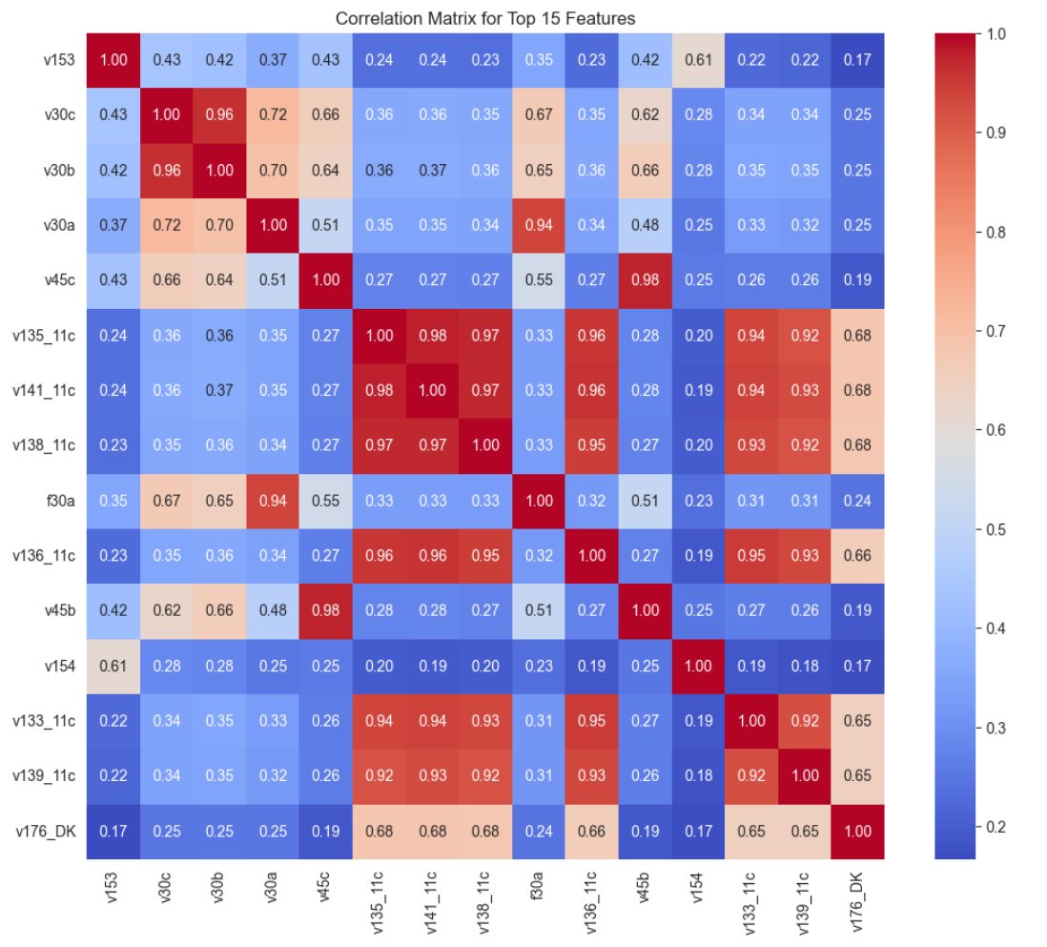
Exploratory Data Analysis
Checking high correlation
Dropped Variables with correlation value over 0.95 to lower overfitting
Dropped features:
'v275c_N1', 'v20a', 'v30b', 'v45b', 'v96a', 'v136_11c', 'v135_11c', 'v141_11c', 'v176_DK', 'v177_DK', 'v181_DK', 'v179_DK', 'v180_DK', 'v182_DK', 'v183_DK', 'v222_DK', 'v223_DK', 'v224_DK', 'age_r', 'age_r3'

Slide 7
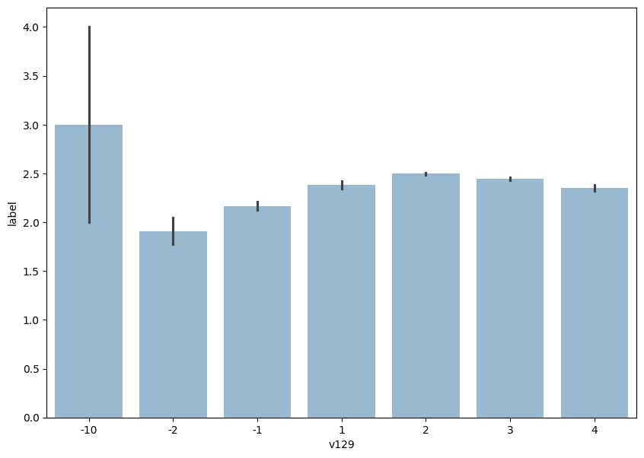
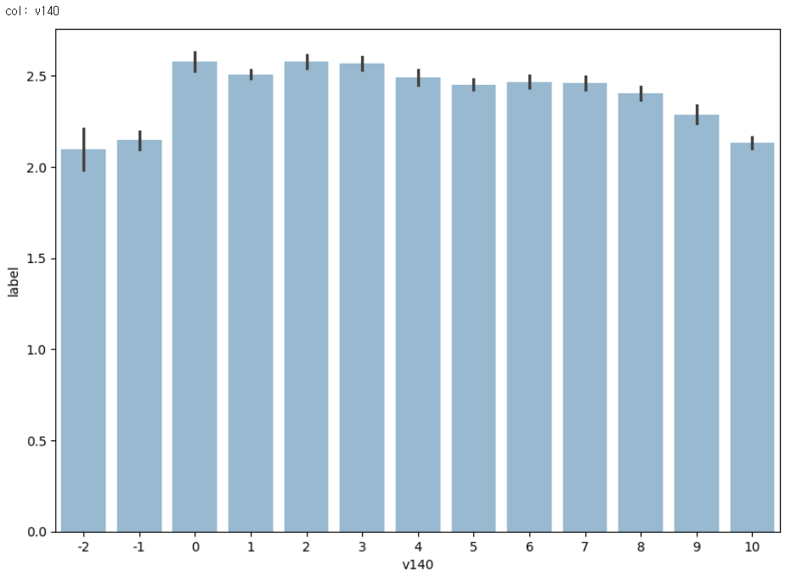
Exploratory Data Analysis
Checking barplots for response variable vs each of explanatory variables
Dropped features with unbalanced CI
Top one is bad, but bottom one is good
Dropped features: ['v24a_IT', 'v52', 'v54', 'v64', 'f96', 'v102', 'v129', 'v172', 'v184', 'v171', 'v215', 'v174_LR']
Found this method causing more overfitting issues. (Mlog_loss was not improved.)

Slide 8
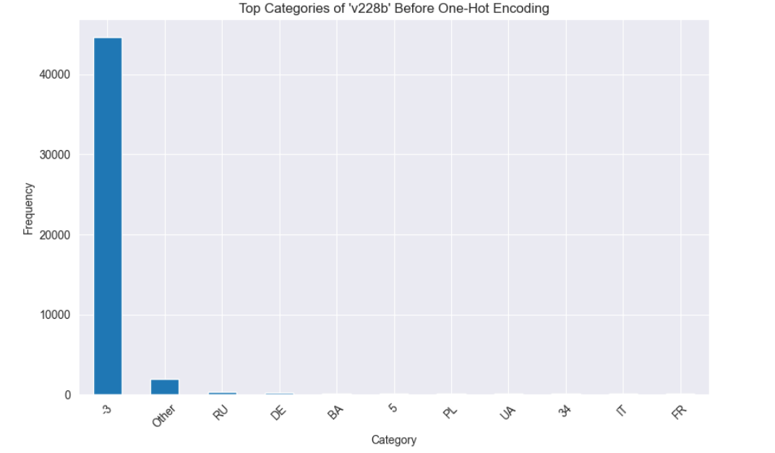
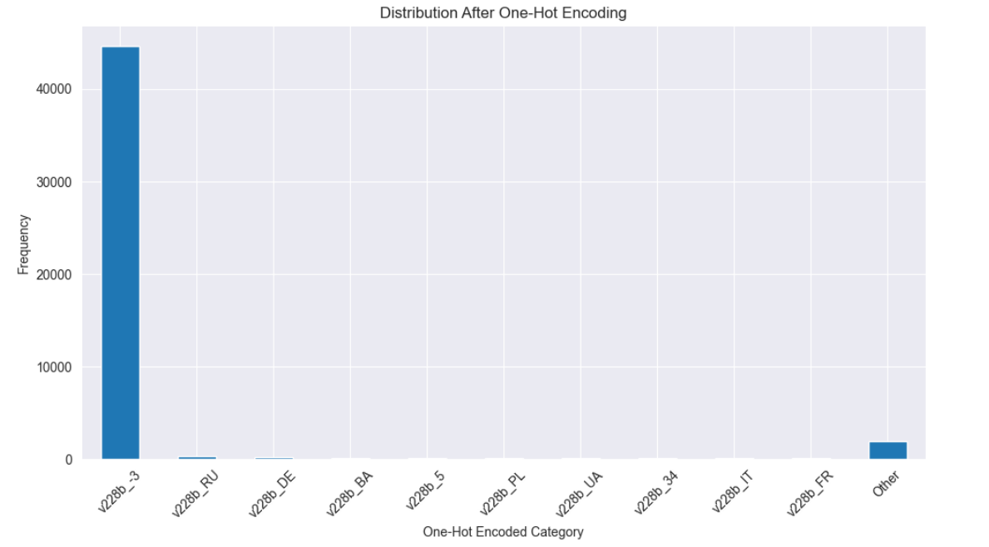
Exploratory Data Analysis
EDA: One Hot Encoding
Removed related Numerical type of variables and performed one hot encoding to String (str4) type of variables:
(ex: v228b, v231b, v233b, 251b, ...)
Used get_dummies from Pandas
Example variable: v228b (respondents country of birth)

Slide 9
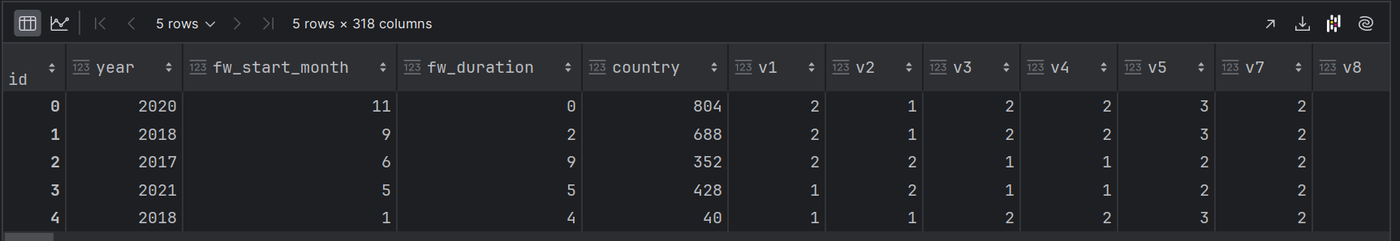
Exploratory Data Analysis - Final
Final EDA version used:
Columns with NA values → Imputation with ‘-3’
Dropped country specific columns (*_GB, *_DE)
Merge Columns
Time related conversion
Dropped Variables with correlation value over 0.95 to lower overfitting
Total # of columns: 318

Slide 10
Model Building
GridSearchCV
Hyperparameter
Tuning
Neural Network
LightGBM
RandomForest
SVM
XGBoost
Bayesian Optimization

Slide 11
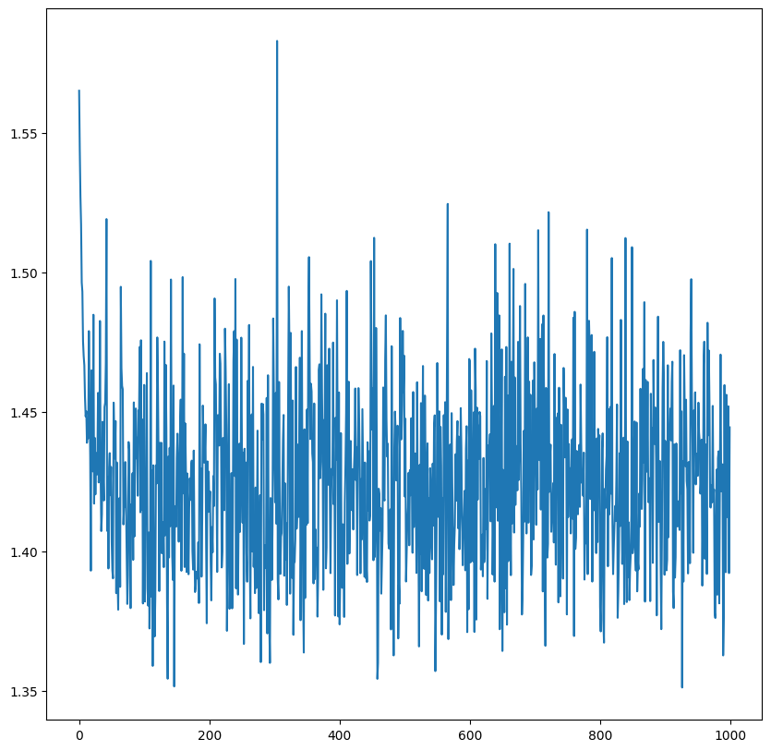
Model Selection - Neural Network
Model for testing
Normalized all numerical variables
3 Hidden layers with sigmoid activation function
LogSoftmax was applied in output layer
Trained with SGD
Loss function : CrossEntropyLoss (not mlog_loss)
Unstable learning curve with training set => bad model
Kaggle Public Score: 1.42958
Kaggle Private Score: 1.42854

Slide 12
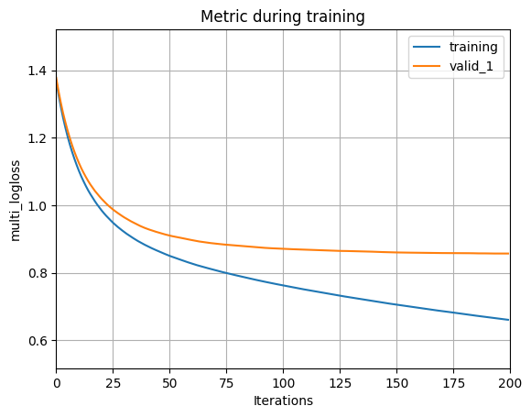
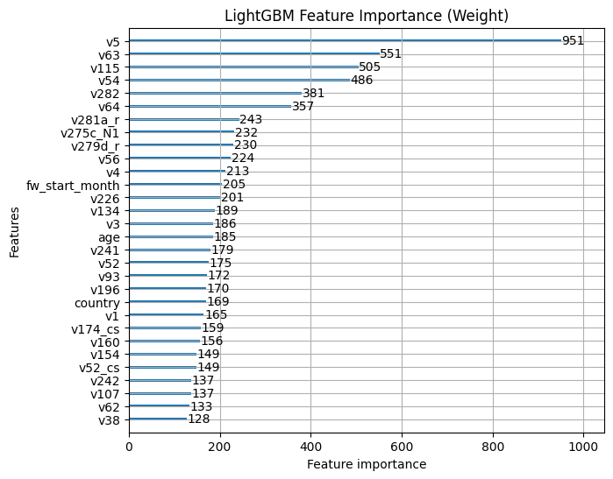
Model Selection - LightGBM
Process:
Use LightGBM package
Set initial default parameter and loop through to find the best parameter
Extremely slow runtime when optimizing the mode parameter
Multiclass Logarithmic Loss:
Training’s multi_logloss: 0.62381
Validation multi_logloss: 0.85574
Kaggle Public Score: 0.87592
Kaggle Private Score: 0.86544

Slide 13
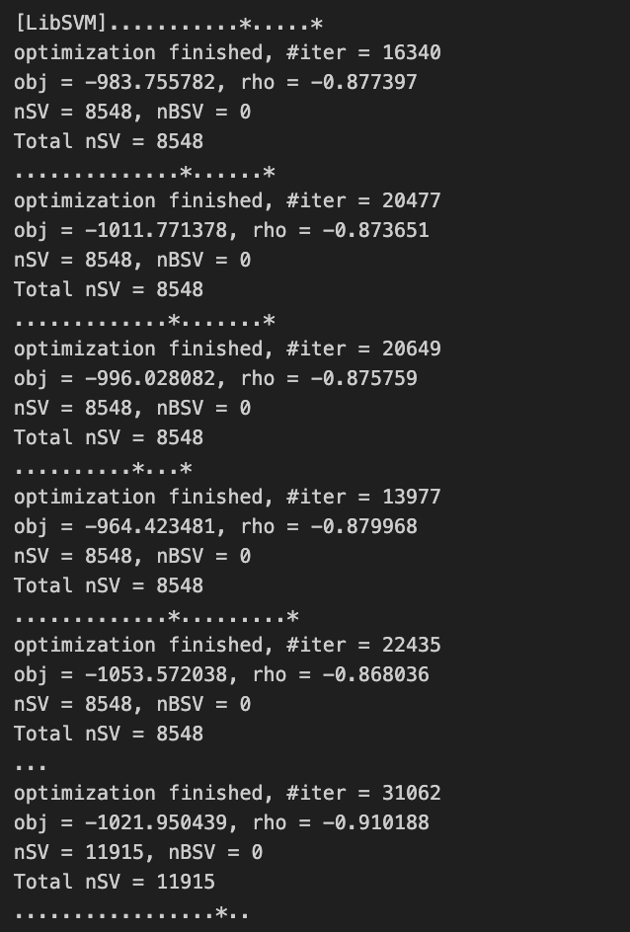
Model Selection - SVM
Support Vector Machine (SVM) is a powerful, supervised machine learning model used for classification, known for its ability to create complex decision boundaries by transforming data into higher dimensions.
Process:
Used Default Parameters to run the SVM
Extremely slow runtime when training the model

Slide 14
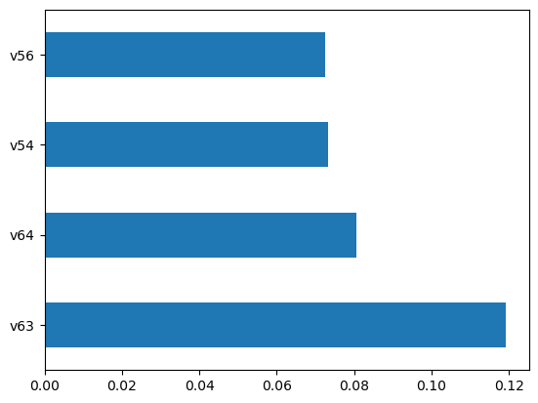
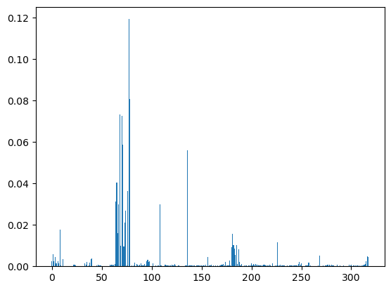
Model Selection - Random Forest
Random Forest is a learning method that constructs multiple decision trees during training and outputs the mode of the classes (for classification) of the individual trees.
Feature Importance:
High Reliance on v63, v64, v54, v56
RandomizedSearchCV
Test Multiclass Logarithmic Loss:
0.9295549658942347

Slide 15
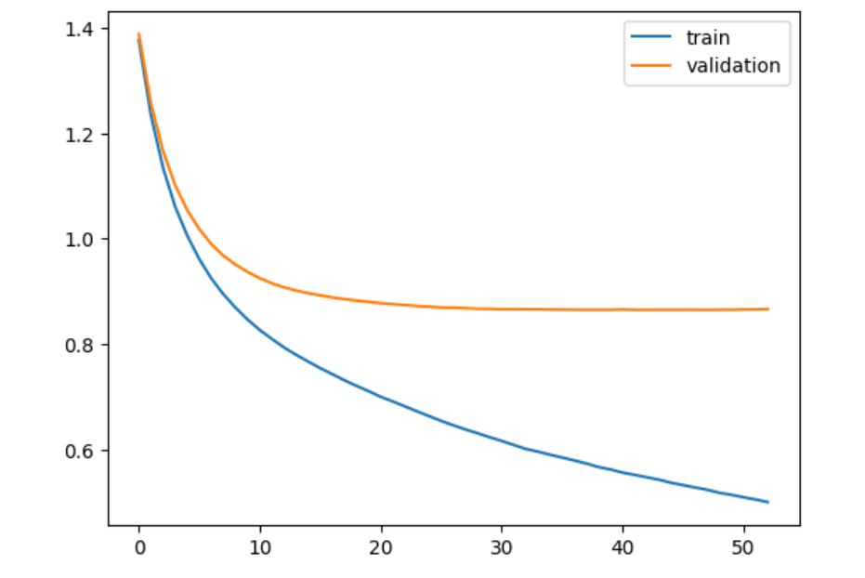
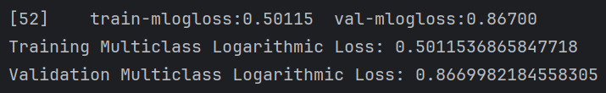
Model Selection - XGBoost
XGBoost is an efficient and scalable gradient boosting framework that uses decision trees and is designed for speed and performance, widely used for classification.
Using ‘xgboost’ library from python
Initial Model with default parameters
Validation drops much slower after 10 iterations
Potential possibility of overfitting

Slide 16
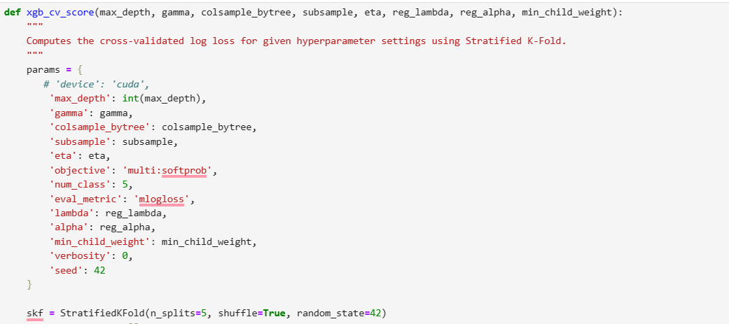
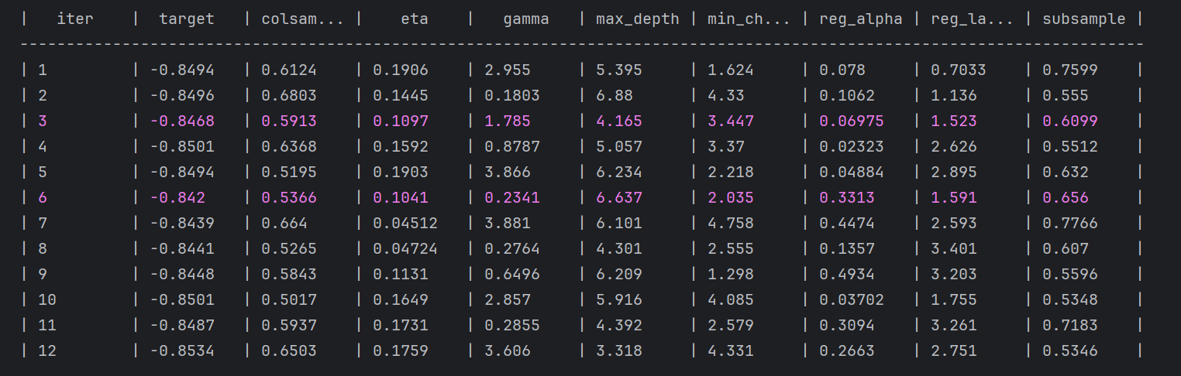
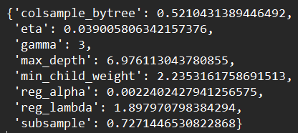
Final Model: XGBoost
Performed Bayesian Optimization for parameter tuning
Implemented stratified k-fold cv with k = 5 to prevent overfitting for the tuning
Total 40 fits
Best Parameter used is below:
bayesian-optimization(github.com)

Slide 17
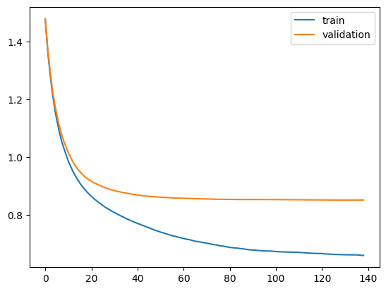
Final Model: XGBoost
Multiclass Log Loss with 569 rounds:
Training: 0.6409
Validation: 0.8418
Final Log Loss with 1000 rounds:
0.6380
Kaggle Public Score: 0.85920
Kaggle Private Score: 0.84454

Slide 18
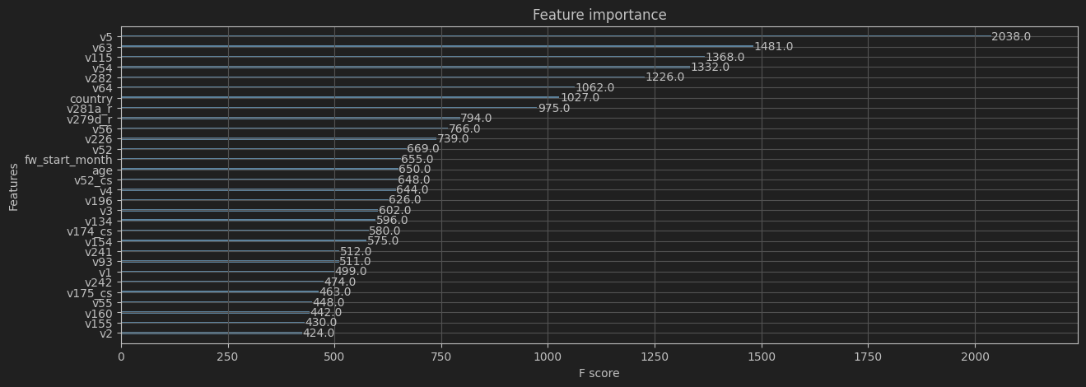
Final Model: XGBoost - Feature Importance
v5: how important in your life: politics, v63: how important is God in your life, v115: how much confidence in: church, v54: how often attend religious services

Slide 19
Possible Further Improvements
Stacking
Decision to focus individual model like XGBoost, and Random Forest was aiming for depth of optimization over breadth of techniques.
Is an area for future exploration to further enhance model performance.
One Hot Encoding
Applying one hot encoding to selected string variable (after more deeper analysis) might be beneficial for future models.

